Slide 1

WIPRO NGA Program – 25SUB4505_5G Developer
Capstone Project Presentation – 13th Feb and 14th Feb 2026
TEST 2: SMF PDU SESSION ESTABLISHMENT
Presented by - Vinayak Majhi - 58618
Harsh Prasad – 58620
Diyanisha Dey - 58621
Keshav Janghala - 58625
Diptendra Maity - 58633
www.rpsconsulting.in

Slide 2
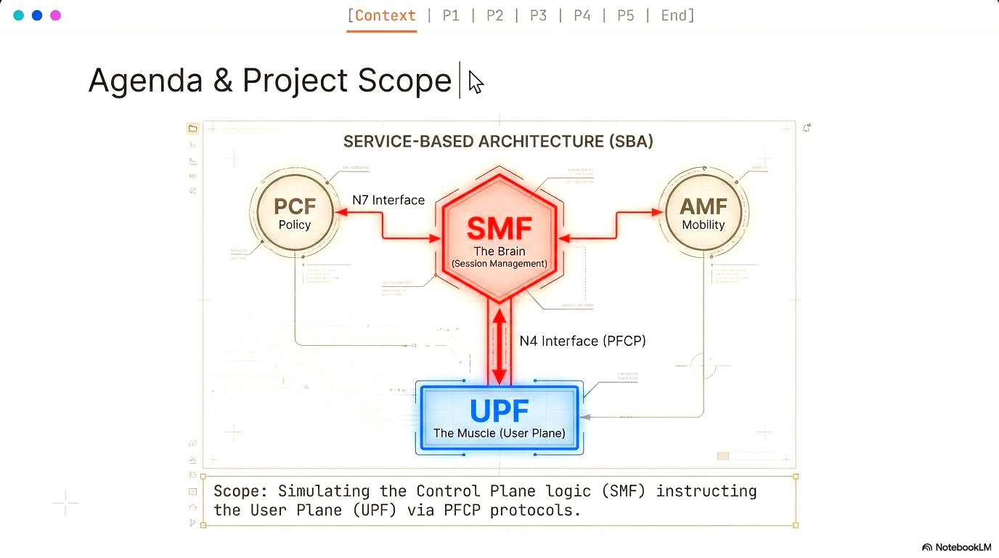

2
2024 - RPS Consulting all rights reserved

Slide 3
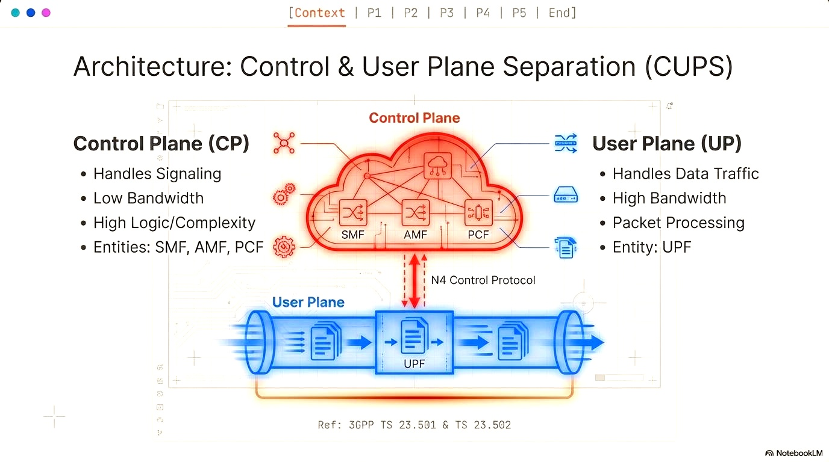
3
2024 - RPS Consulting all rights reserved

Slide 4
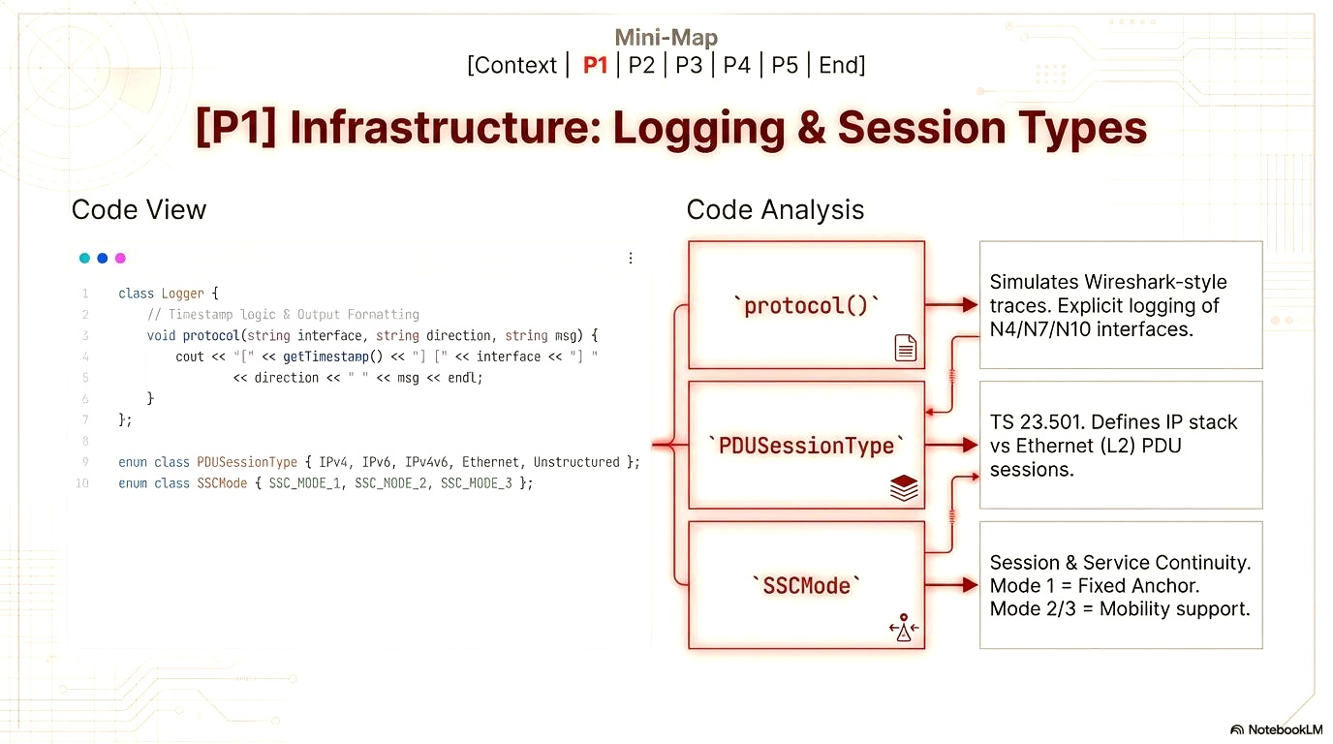
4
2024 - RPS Consulting all rights reserved

Slide 5
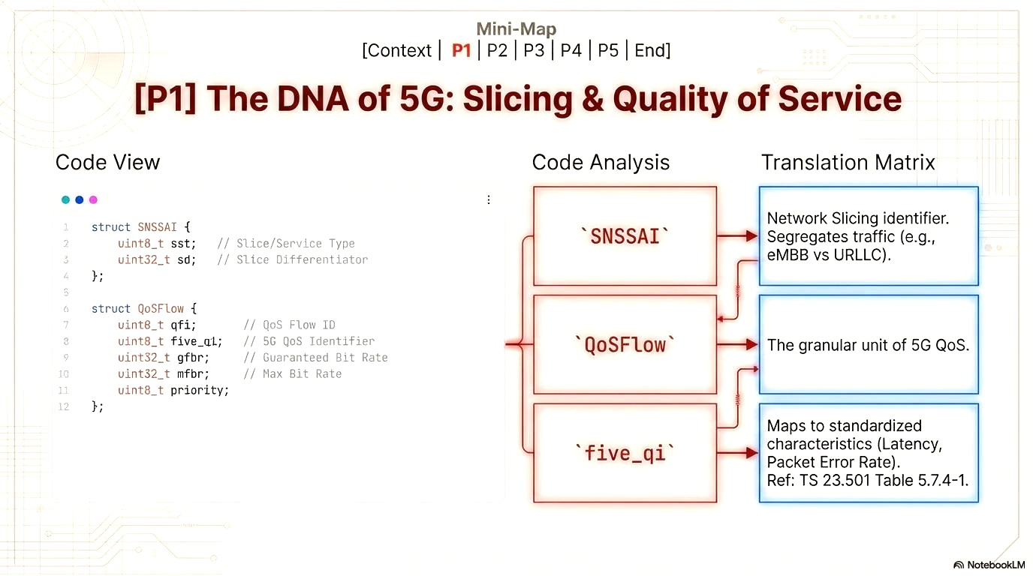
5
2024 - RPS Consulting all rights reserved

Slide 6
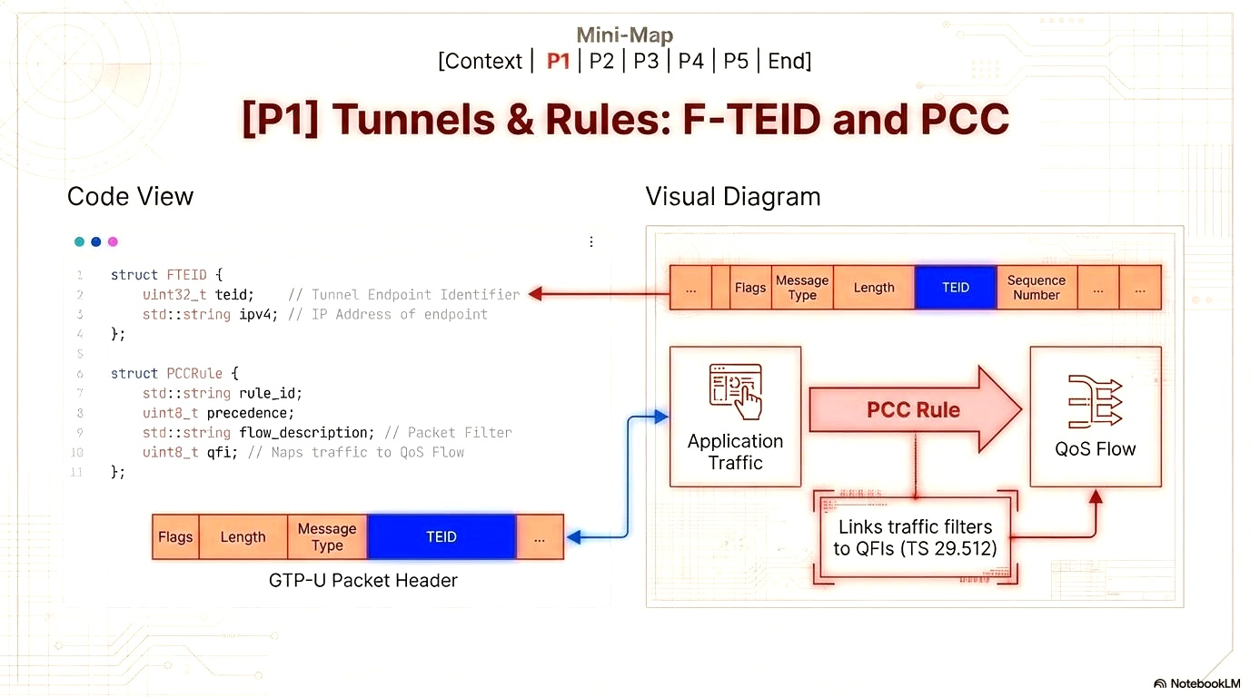
6
2024 - RPS Consulting all rights reserved

Slide 7
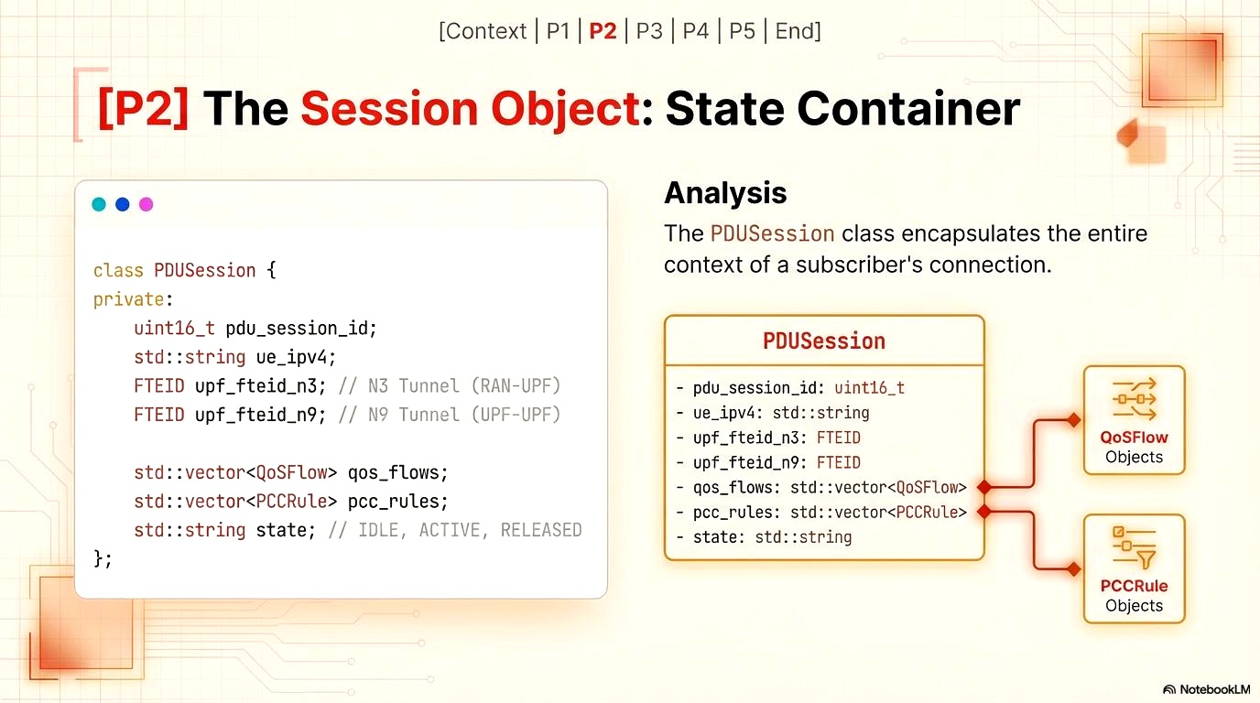
7
2024 - RPS Consulting all rights reserved

Slide 8
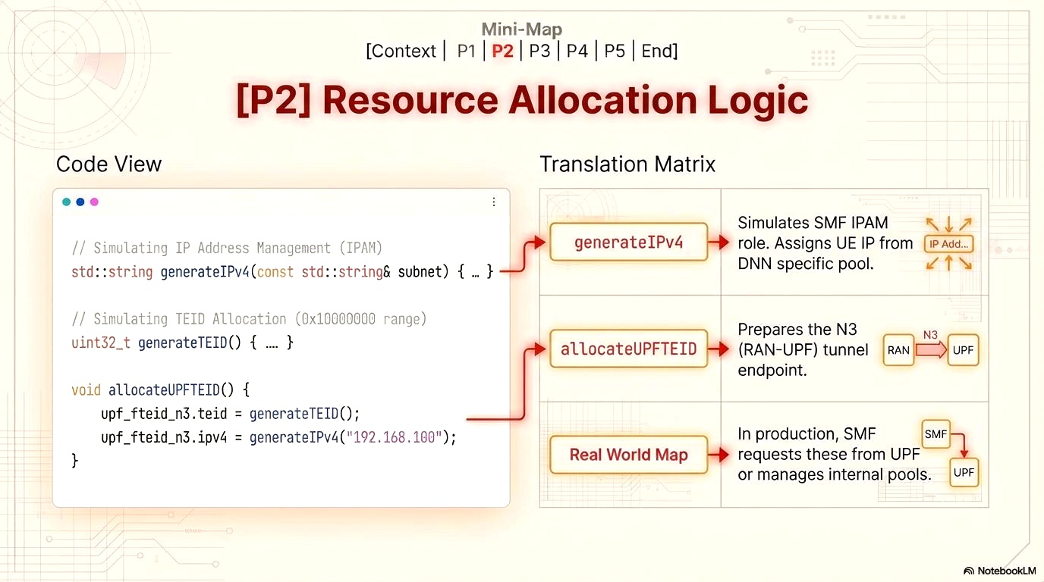
8
2024 - RPS Consulting all rights reserved

Slide 9
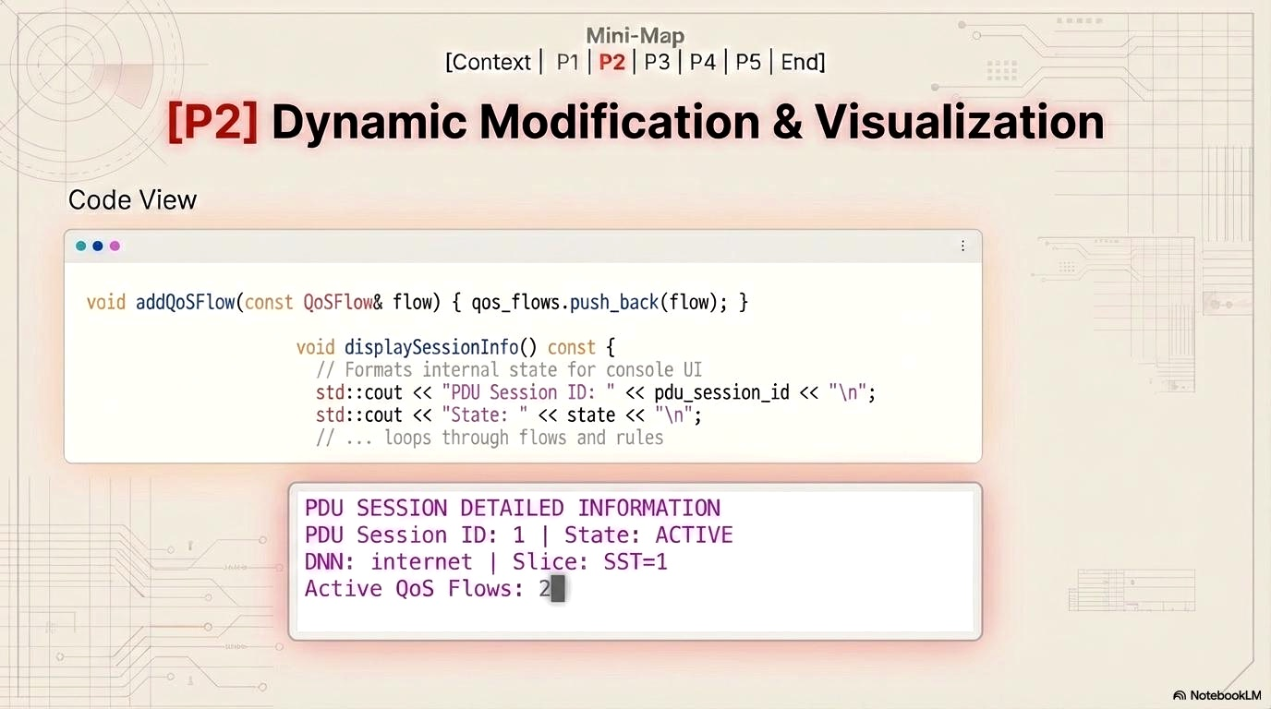
9
2024 - RPS Consulting all rights reserved

Slide 10
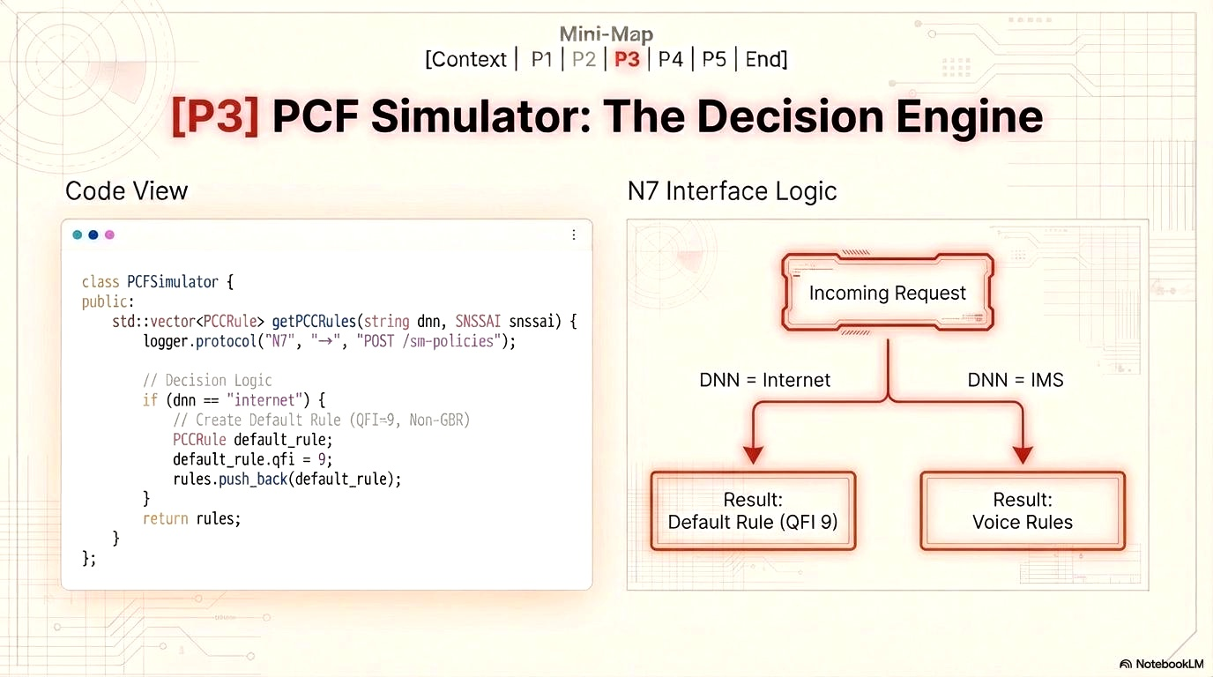
10
2024 - RPS Consulting all rights reserved

Slide 11
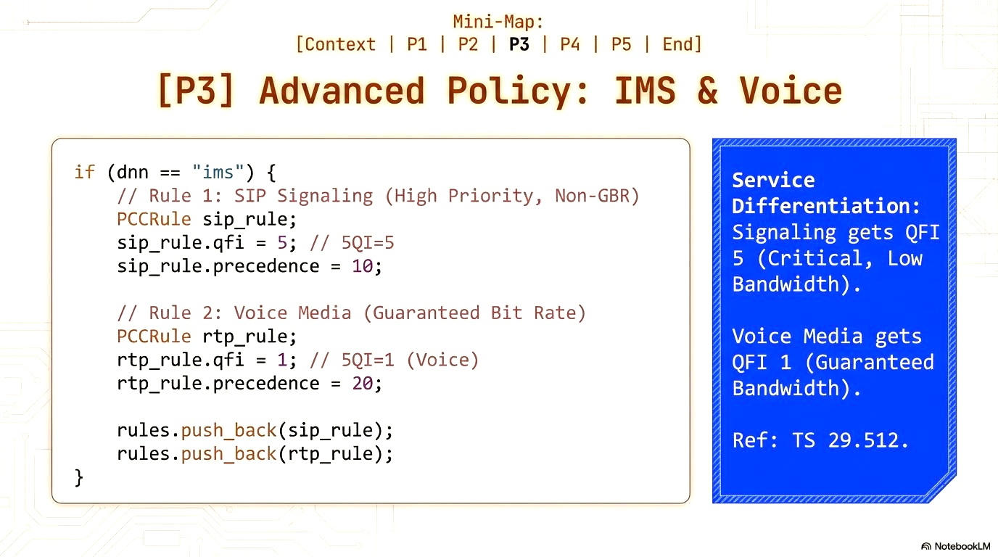
11
2024 - RPS Consulting all rights reserved

Slide 12
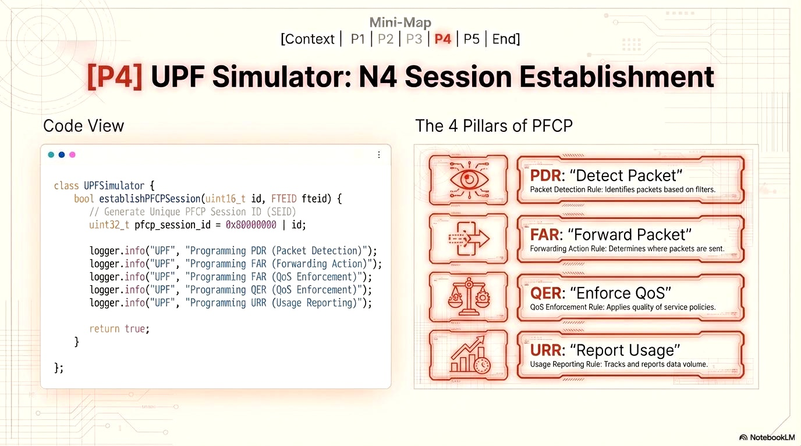
12
2024 - RPS Consulting all rights reserved

Slide 13
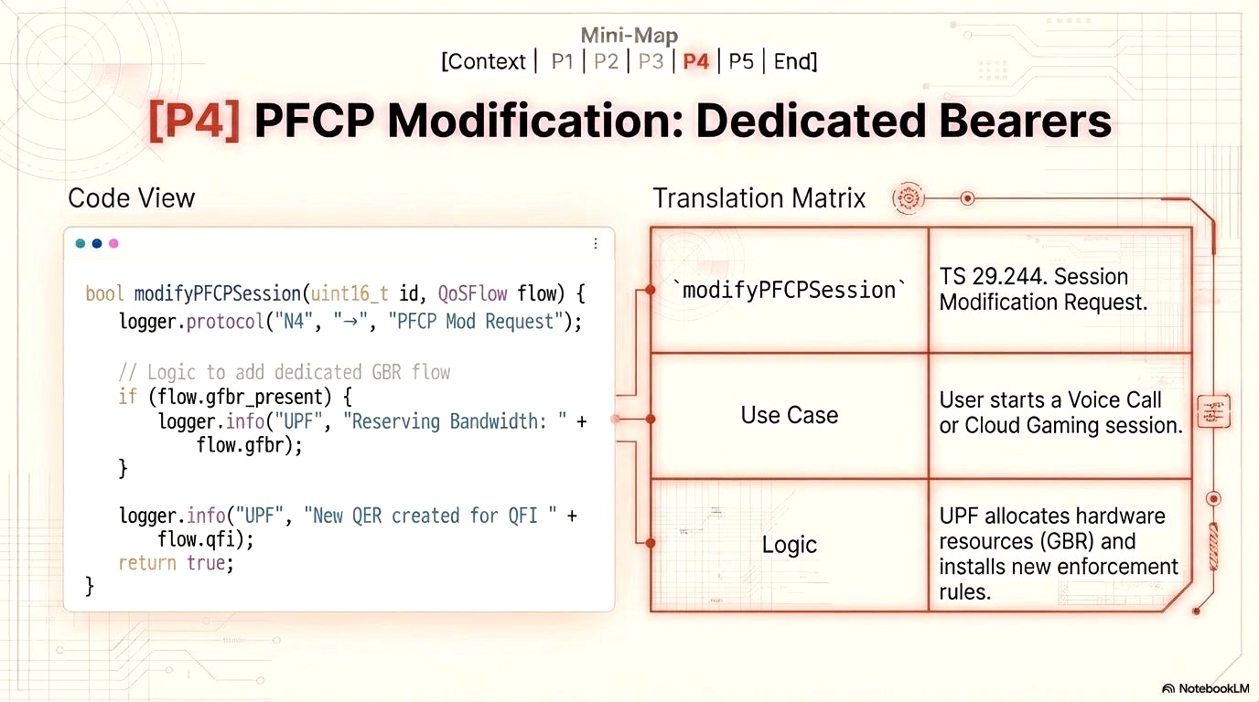
13
2024 - RPS Consulting all rights reserved

Slide 14
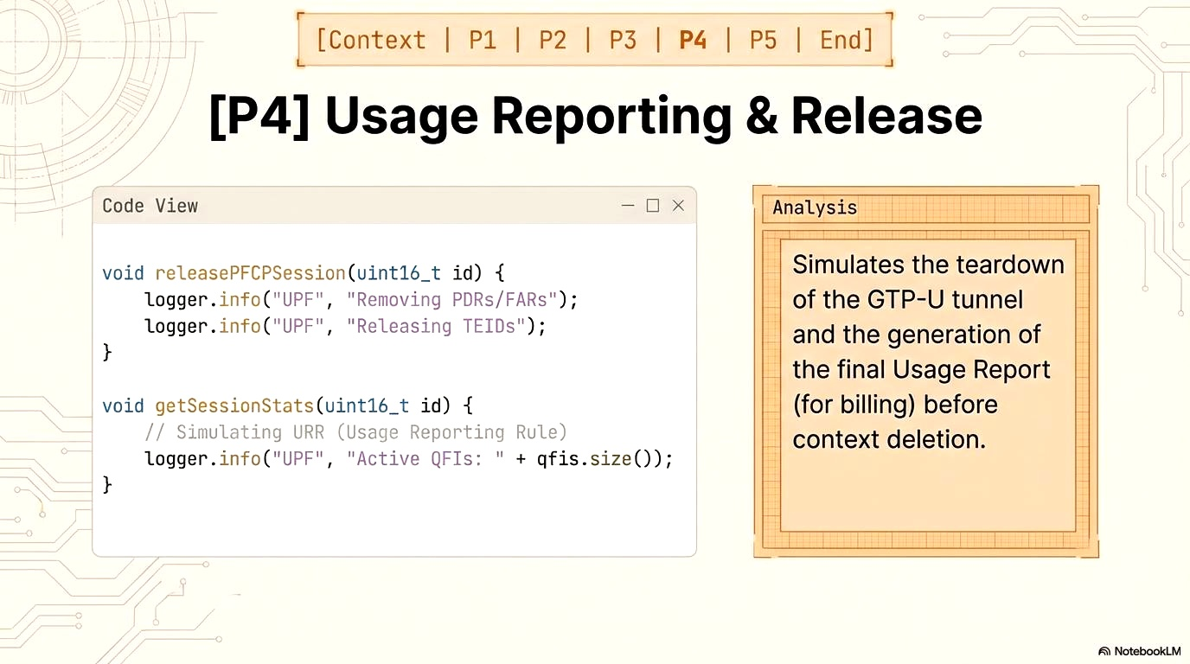
14
2024 - RPS Consulting all rights reserved

Slide 15
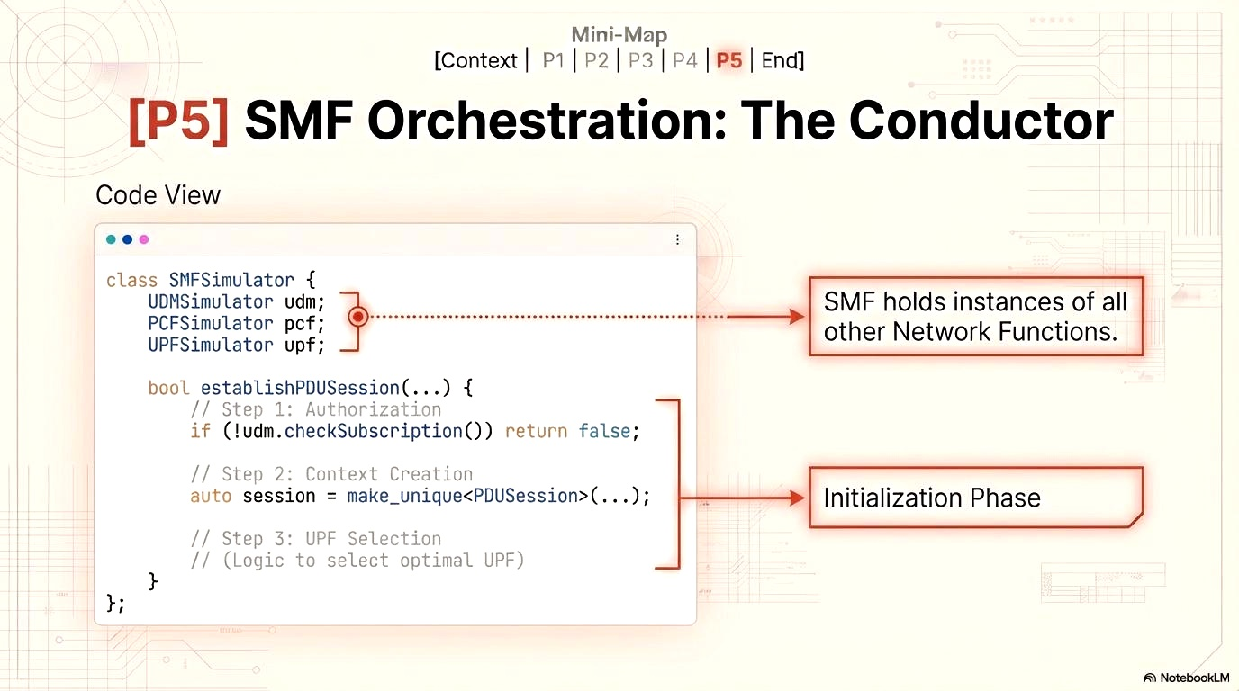
15
2024 - RPS Consulting all rights reserved

Slide 16
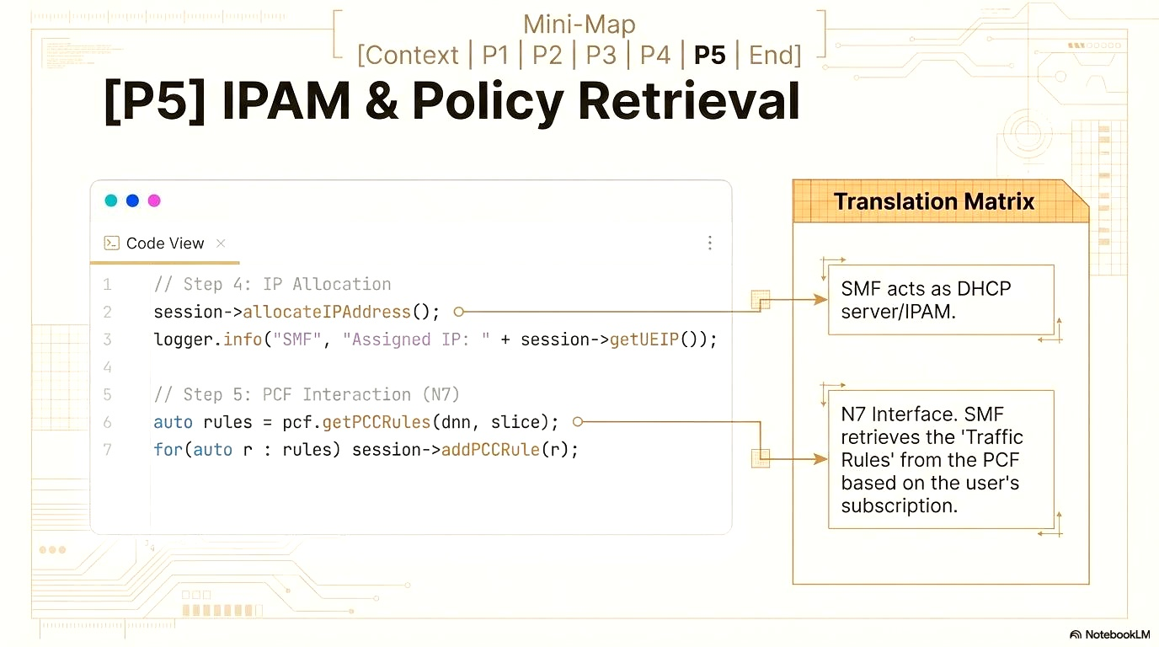
16
2024 - RPS Consulting all rights reserved

Slide 17
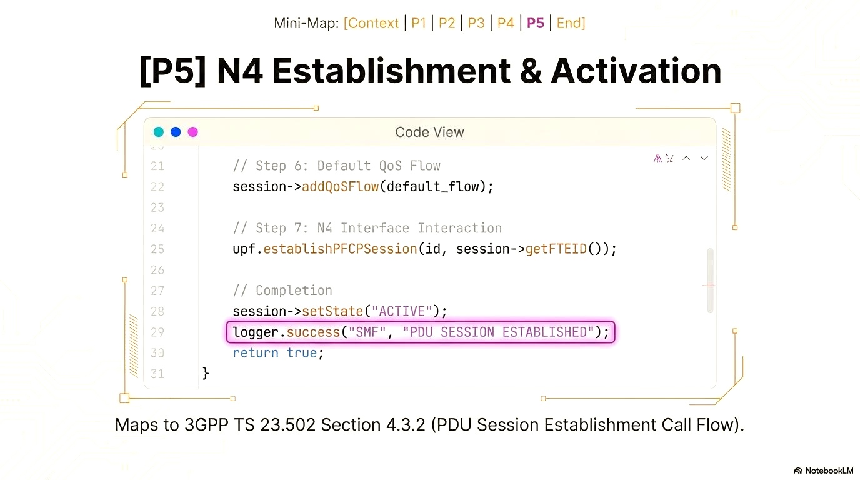
17
2024 - RPS Consulting all rights reserved

Slide 18
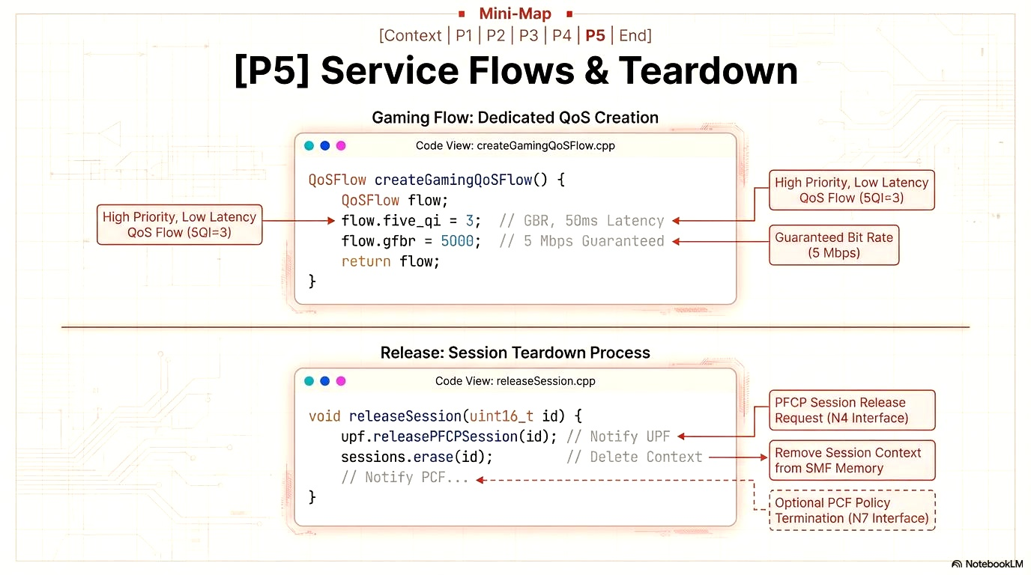
18
2024 - RPS Consulting all rights reserved

Slide 19
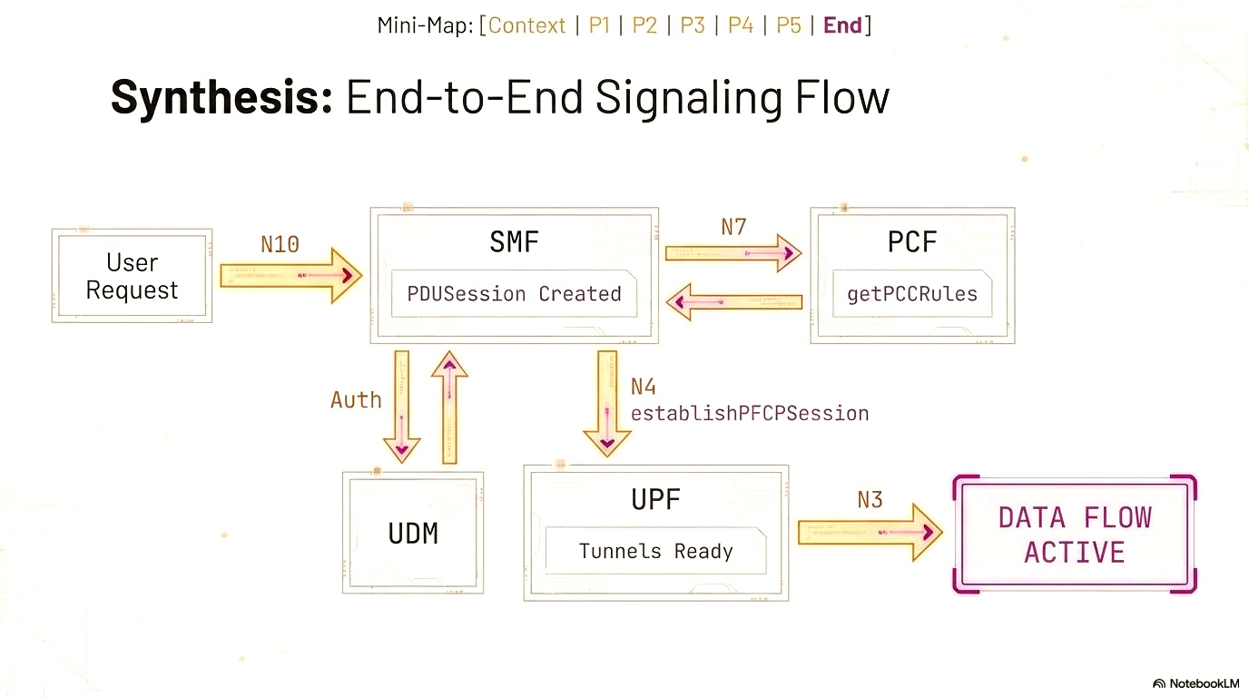
19
2024 - RPS Consulting all rights reserved

Slide 20
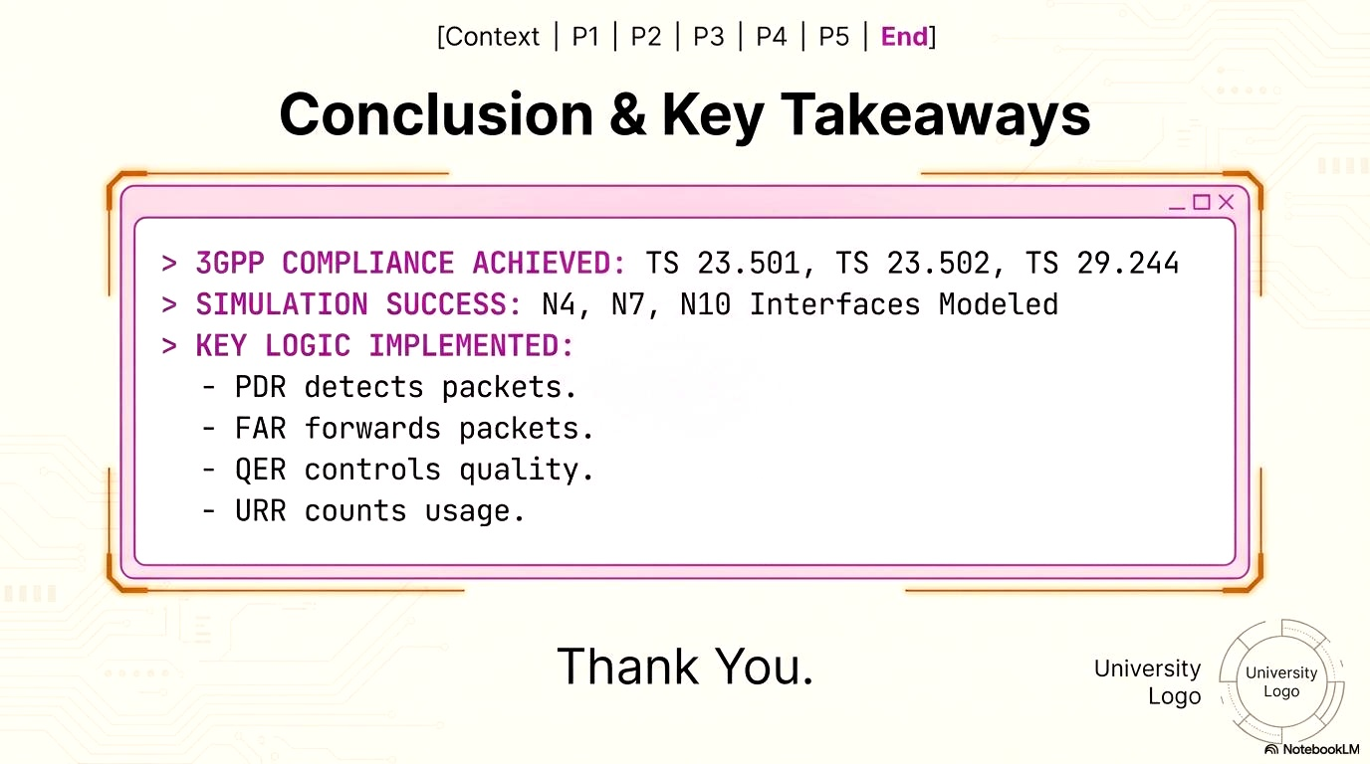
20
2024 - RPS Consulting all rights reserved

